Slide 1
Multicore Design Considerations
KeyStone Training
Multicore Applications
Literature Number: SPRP811

Slide 2
Objectives
The purpose of this lesson is to enable you to do the following:
Explain the importance of multicore parallel processing in both current and future applications.
Define different types of parallel processing and the possible limitations and dependencies of each.
Explain the importance of memory features, architecture, and data movement for efficient parallel processing.
Identify the special features of KeyStone SoC devices that facilitate parallel processing.
Build a functionally-driven parallel project:
Analyze the TI H264 implementation.
Build a data-driven parallel project:
Build, run, and analyze the TI Very Large FFT (VLFFT) implementation
Build ARM-DSP KeyStone II typical application
Analyze a possible CAT Scan processing system

Slide 3
Agenda
Multicore Programming Overview
Parallel Processing
Partitioning
Multicore Software
Multicore Partitioning Examples

Slide 4
Multicore Programming Overview
Multicore Design Considerations

Slide 5
Definitions
Parallel Processing refers to the usage of simultaneous processors to execute an application or multiple computational threads.
Multicore Parallel Processing refers to the usage of multiple cores in the same device to execute an application or multiple computational threads.

Slide 6
Multicore: The Forefront of Computing Technology
Multicore supports Moore’s Law by adding multiple core performance to a device.
Quality criteria: Number of watts per cycle
“We’re not going to have faster processors. Instead, making software run faster in the future will mean using parallel programming techniques. This will be a huge shift.” -- Katherine Yelick, Lawrence Berkeley National Laboratory from The Economist: Parallel Bars

Slide 7
Marketplace Challenges
Increased data rate
For example, Ethernet; From 10Mbps to 10Gbps
Increased algorithm complexity
For example, biometrics (facial recognition, fingerprints, etc.)
Increased development cost
Hardware and software development
Multicore SOC devices are a solution
Fast peripherals incorporated into the device
High-performance, fixed- and floating-point processing power
Parallel data movement
Off-the-shelf devices
Elaborate set of software development tools

Slide 8
Common Use Cases
Voice processing in network gateways:
Typically hundreds or thousands of channels
Each channel consumes about 30 MIPS
Large, complex, floating-point FFT (Radar applications and others)
Video processing
Medical imaging
LTE, WiMAX, and other wireless physical layers
Scientific processing of large, complex matrix manipulations (e.g., oil exploration)

Slide 9
Parallel Processing
Multicore Design Considerations

Slide 10
Parallel Processing Models Master-Slave Model (1/2)
Centralized control and distributed execution
Master is responsible for execution, scheduling, and data availability.
Requires fast and cheap (in terms of CPU resources) messages and data exchange between cores
Typical applications consist of many small independent threads.
Note, for KeyStone II, the ARM core can be the master core and DSP cores be the slaves

Slide 11
Parallel Processing Models Master-Slave Model (2/2)
Master
Slave
Slave
Slave
Applications
Multiple media processing
Video encoder slice processing
JPEG 2000; multiple frames
VLFFT

Slide 12
Parallel Processing Models Data Flow Model (1/2)
Distributed control and execution
The algorithm is partitioned into multiple blocks.
Each block is processed by a core.
The output of one core is the input to the next core.
Data and messages are exchanged between all cores
Challenge: How should blocks be partitioned to optimize performance?
Requires a loose link between cores (queue system)

Slide 13
Parallel Processing Models Data Flow Model (2/2)
Core 0
Core 1
Core 2
Applications
High-quality video encoder
Video decoder, transcoder
LTE physical layer
CAT Scan processing

Slide 14
Partitioning
Multicore Design Considerations

Slide 15
Partitioning Considerations
An application is a set of algorithms. In order to partition an application into multiple cores, the system architect needs to consider the following questions:
Can a certain algorithm be executed on multiple cores in parallel?
Can the data be divided between two cores?
FIR filter can be, IIR filter cannot
What are the dependencies between two (or more) algorithms?
Can they be processed in parallel?
Can one algorithm must wait for the next?
Example: Identification based on fingerprint and face recognition can be done in parallel. Pre-filter and then image reconstruction in CT must be done in sequence.
Can the application can run concurrently on two sets of data?
JPEG2000 video encoder; Yes
H264 video encoder; No

Slide 16
Common Partitioning Methods
Function-driven Partition
Large tasks are divided into function blocks
Function blocks are assigned to each core
The output of one core is the input of the next core
Use cases: H.264 high-quality encoding and decoding, LTE
Data-driven Partition
Large data sets are divided into smaller data sets
All cores perform the same process on different blocks of data
Use cases: image processing, multi-channel speech processing, sliced-based encoder
Mixed Partition
Consists of both function-driven and data-driven partitioning

Slide 17
Multicore SOC Design Challenges
Multicore Design Considerations

Slide 18
Multicore SOC Design Challenges
I/O bottlenecks: Getting large amount of data into the device and out of the device
Enabling high-performance computing, where lots of operations are performed on multiple cores
Powerful fixed-point and floating-point cores
Ensuring efficient data sharing and signaling between cores without stalling execution
Minimizing contention for use of shared resources by multiple cores

Slide 19
Input and Output Data
Fast peripherals are needed to:
Receive high bit-rate data into the device
Transmit the processed HBR data out of the device
KeyStone devices have a variety of high bit-rate peripherals, including the following:
10/100/1000 Mpbs Ethernet
10G Ethernet
SRIO
PCIe
AIF2
TSIP

Slide 20
Powerful Cores
8 functional units of the C66x CorePac provide:
Fixed- and Floating-point native instructions
Many SIMD instructions
Many Special Purpose Powerful instructions
Fast (0 wait state) L1 memory
Fast L2 memory
ARM Core provides
Fixed- and Floating-point native instructions
Many SIMD instructions
Fast (0 wait state) private L1 cache memory for each A15
Fast shared coherent L2 cache memory

Slide 21
Data Sharing Between Cores
Shared memory
KeyStone SoC devices include very fast and large external DDR interface(s).
DSP Core provides 32- to 36-bit address translation enables access of up to 10GB of DDR. ARM core uses MMU to translate 32 bits logical address into 40 bits physical address
Fast, shared L2 memory is part of the sophisticated and fast MSMC.
Hardware provides ability to move data and signals between cores with minimal CPU resources.
Powerful transport through Multicore Navigator
Multiple instances of EDMA
Other hardware mechanisms that help facilitate messages and communications between cores.
IPC registers, semaphore block

Slide 22
Minimizing Resource Contention
Each DSP CorePac has a dedicated port into the MSMC.
MSMC supports pre-fetching to speed up loading of data.
Shared L2 has multiple banks of memory that support concurrent multiple access.
ARM core uses AMBA bus to connect directly to the MSMC, provide coherency and efficiency
Wide and fast parallel Teranet switch fabric provides priority-based parallel access.
Packet-based HyperLink bus enables the seamless connection of two KeyStone devices to increase performance while minimizing power and cost.

Slide 23
Multicore Software
Multicore Design Considerations

Slide 24
Software Offerings: System
MCSDK is a complete set of software libraries and utilities developed for KeyStone SoC devices.
ARM linux operating system brings the richness of open source Linux utility. Linux kernel supports device control and communications
A full set of LLDs is supplemented by CSL utilities to provide software access to all device peripherals and coprocessors.
In particular, KeyStone provides a set of software utilities that facilitate messages and communications between cores such as IPC and msgCom for communication, Linux drivers on ARM and LLD on the DSP for easy control of IP and peripherals

Slide 25
Software Offering: Applications
TI supports common parallel programming languages:
OpenMP; Part of the compiler release
OpenCL; Plans to support in future releases

Slide 26
Software Support: OpenMP
OpenMP (Supported by TI compiler tools)
API for writing multi-threaded applications
API includes compiler directives and library routines
C, C++, and Fortran support
Standardizes last 20 years of Shared-Memory Programming (SMP) practice

Slide 27
Multicore Partitioning Examples
Multicore Design Considerations

Slide 28
Partitioning Method Examples
Function-driven Partition
H264 encoder
Data-driven Partition
Very Large FFT
ARM – DSP partition
CAT Scan application

Slide 29
Multicore Partitioning Examples
Example 1: High Def 1080i60 Video H264 Encoder
Data Flow Model
Function-driven Partition

Slide 30
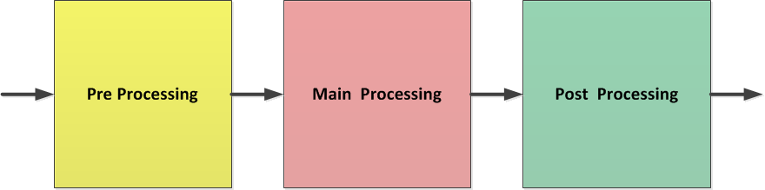
Video Compression Algorithm
Video compression is performed frame after frame.
Within a frame, the processing is done row after row.
Video compression is done on macroblocks (16x16 pixels).
Video compression can be divided into three parts: pre-processing, main processing and post-processing

Slide 31
Dependencies and limitations
Pre-processing cannot work on frame (N) before frame (N-1) is done, but there is no dependency between macroblock, That is, multiple cores can divide the input data for the preprocessing.
Main processing cannot work on frame (N) before frame (N-1) is done, and each macroblock depends on the macroblocks above and to left. That is, there is no way to use multiple cores on main processing.
Post processing must work on complete frame, but there is no dependency between consecutive frames. That is, post processing can process frame(N) before frame (N-1) is done.

Slide 32
Video Encoder Processing Load
Coder | Width | Height | Frames/Second | MCycles/Second
D1(NTSC) | 720 | 480 | 30 | 660
D1 (PAL) | 720 | 576 | 25 | 660
720P30 | 1280 | 720 | 30 | 1850
1080i | 1920 | 1080 (1088) | 60 fields | 3450
Module | Percentage | Approximate MIPS (1080i)/Second | Number of Cores
Pre-Processing | ~50% | 1750 | 2
Main Processing | ~25% | 875 | 1
Post-Processing | ~25% | 875 | 1
Notes:
Entropy decoder – decodes each frame independently
Motion estimation – varies algorithm, but there are often interdependencies

Slide 33
How Many Channels Can One C6678 Process?
Looks like two channels; Each one uses four cores.
Two cores for pre-processing
One core for main processing
One core for post-processing
What other resources are needed?
Streaming data in and out of the system
Store and load data to and from DDR
Internal bus bandwidth
DMA availability
Synchronization between cores, especially when trying to minimize delay

Slide 34
What are the System Input Requirements?
Stream data in and out of the system:
Raw data: 1920 * 1080 * 1.5 = 3,110,400 bytes per frame = 24.883200 bits per frame (~25M bits per frame)
At 30 frames per second, the input is 750 Mbps
NOTE: The order of raw data for a frame is Y component first, followed by U and V.
750 Mbps input requires one of the following:
One SRIO lane (5 Gbps raw; Approximately 3.5 Gbps of payload),
One PCIe lane (5 Gbps raw)
NOTE: KeyStone devices provide four SRIO lanes and two PCIe lanes
Compressed data (e.g., 10 to 20 Mbps) can use SGMII (10M/100M/1G) or SRIO or PCIe.

Slide 35
How Many Accesses to the DDR?
For purposes of this example, only consider frame-size accesses.
All other accesses are negligible.
Requirements for processing a single frame: Total DDR access for a single frame is less than 32 MB.

Slide 36
How Does This Access Avoid Contention?
Total DDR access for a single frame is less than 32 MB.
The total DDR access for 30 frames per second (60 fields) is less than 32 * 30 = 960 MBps.
The DDR3 raw bandwidth is more than 10 GBps (1333 MHz clock and 64 bits). 10% utilization reduces contention possibilities.
DDR3 DMA uses TeraNet with clock/3 and 128 bits. TeraNet bandwidth is 400 MHz * 16B = 6.4 GBps.

Slide 37
KeyStone SoC Architecture Resources
10 EDMA transfer controllers with 144 EDMA channels and 1152 PaRAM (parameter blocks):
The EDMA scheme must be designed by the user.
The LLD provides easy EDMA usage.
In addition, Multicore Navigator has its own PKTDMA for each master.
Data in and out of the system (SRIO or SGMII) is done using the Multicore Navigator or another master DMA (e.g., PCIe).
All synchronization and data movement is done using IPC.

Slide 38
Conclusion
Two H264 high-quality 1080i encoders can be processed on a single TMS320C6678.

Slide 39
System Architecture

Slide 40
Multicore Partitioning Examples
Example 2: Very Large FFT (VLFFT) – 1M Floating Point
Master/Slave Model
Data-driven Partition

Slide 41
Outline
Basic Algorithm for Parallelizing DFT
Multicore Implementation of DFT
Review Benchmark Performance
Algorithm is based on a published paper:
Very Large Fast DFT (VL FFT)
Implement High-Performance Parallel FFT Algorithms for the HITACHI SR8000
Daisuke Takahashi, Information Technology Center, University of Tokyo
Published in: High Performance Computing in the Asia-Pacific Region, 2000. Proceedings. The Fourth International Conference/Exhibition on (Volume:1 )

Slide 42
Algorithm for Very Large DFT
A generic Discrete Fourier Transform (DFT) is shown below.
Where N is the total size of DFT.

Slide 43
Develop The Algorithm: Step 1
Make a matrix of N_{1(rows)} * N_{2(columns)} = N
such that:
k = k₁ * N₁ ₊ k₂
k₁ = 0, 1,..N₂-1 k₂ = 0, 1,..N₁-1
It is easy (just substitution) to show that:

Slide 44
Develop The Algorithm: Step 2
In a similar way, we can write that:
n = u₁ * N₁ ₊ u₂
u₁ = 0, 1,..N₂-1 u₂ = 0, 1,..N₁-1
and then:

Slide 45
Develop The Algorithm: Step 3
Next, we observe that the exponent can be written as three terms. The fourth term is always one ( =1)

Slide 46
Develop The Algorithm: Step 4
Look at the middle term. This is exactly FFT at the point u₂
for different K₂. (sum on k₁, N₂ is a parameter and u₂ is the output value). Let’s write it as FFT_{K2} (u₂). There are N₂ different
FFT; Each of them is of size N₁.

Slide 47
Develop The Algorithm: Step 5
Look again at the middle term inside the sum. This is the FFT at the point u₂ for different K₂ multiplied by a function (twiddle factor) of K₂ and u₂ . Let’s write it as Z_{u2} (k₂).
Next we transpose the matrix, also called a “corner turn.” This means taking the u₂ element (multiplied by the twiddle factor) from each previously calculated FFT result. We now use this element to perform N₂ FFTs; Each of them is size N₁.

Slide 48
Algorithm for Very Large DFT
A very large DFT of size N=N1*N2 can be computed in the following steps:
Formulate input into N1xN2 matrix
Compute N2 FFTs size N1
Multiply global twiddle factors
Matrix transpose: N2xN1 -> N1xN2
Compute N1 FFTs. Each is N2 size.

Slide 49
Implementing VLFFT on Multiple Cores
Two iterations of computations
1st iteration
N2 FFTs are distributed across all the cores.
Each core implements matrix transpose and computes the N2/numCores FFTs and multiplying twiddle factor.
2nd iteration
N1 FFTs of N2 size are distributed across all the cores.
Each core computes N1/numCores FFTs and implements matrix transpose before and after FFT computation.

Slide 50
Data Buffers
DDR3: Three float complex arrays of size N
Input buffer
Output buffer
Working buffer
L2 SRAM:
Two ping-pong buffers; Each buffer is the size of 16 FFT input/output
Some working buffer
Buffers for twiddle factors:
Twiddle factors for N1 and N2 FFT
N2 global twiddle factors

Slide 51
Global Twiddle Factors
Global Twiddle Factors:
Total of N1*N2 global twiddle factors are required.
N1 (N2 is N2>N1) are actually pre-computed and saved.
The rest are computed during run time.

Slide 52
DMA Scheme
Each core has dedicated in/out DMA channels.
Each core configures and triggers its own DMA channels for input/output.
On each core, the processing is divided into blocks of 8 FFT each.
For each block on every core:
DMA transfers 8 lines of FFT input
DSP computes FFT/transpose
DMA transfers 8 lines of FFT output

Slide 53
Matrix Transpose
The transpose is required for the following matrixes from each core:
N1x8 -> 8xN1
N2x8 -> 8xN2
8xN2 -> N2x8
DSP computes matrix transpose from L2 SRAM
DMA brings samples from DDR to L2 SRAM
DSP implements transpose for matrixes in L2 SRAM
32K L1 Cache

Slide 54
Major Kernels
FFT: single-precision, floating-point FFT from c66x DSPLIB
Global twiddle factor compute and multiplication: 1 cycle per complex sample
Transpose: 1 cycle per complex sample

Slide 55
Major Software Tools
SYS BIOS 6
CSL for EDMA configuration
IPC for inter-processor communication

Slide 56
Conclusion
After the demo …

Slide 57
Multicore Partitioning Examples
Example 3: ARM – DSP partition
CAT Scan application

Slide 58
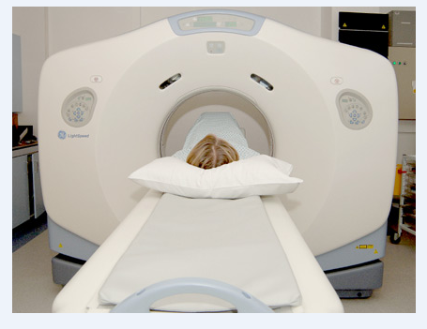
CT Scan Machine
X-Ray source rotates around the body while a set of detectors (1D, 2D) collects values
Requirements:
Minimize exposure to X-Ray
Obtain quality view of internal anatomy
Technician monitors in real-time the quality of the imaging

Slide 59
Computerized Tomography: Trauma case
Scanning hundreds slices to determine if there is internal damage. Each slice takes about a second.
At the same time, a physician sits in front of the display and has the ability to manipulate the images:
Rotate the images
Color certain values
Edge detection
Other image processing algorithms

Slide 60
CT Algorithm Overview
A typical system has a parallel source of x-rays and a set of detectors.
Each detector detects the absorption of the line integral between the source and the detector.
The source rotates around the body and the detectors collect N sets of data.
The next slide demonstrates the geometry

Slide 61
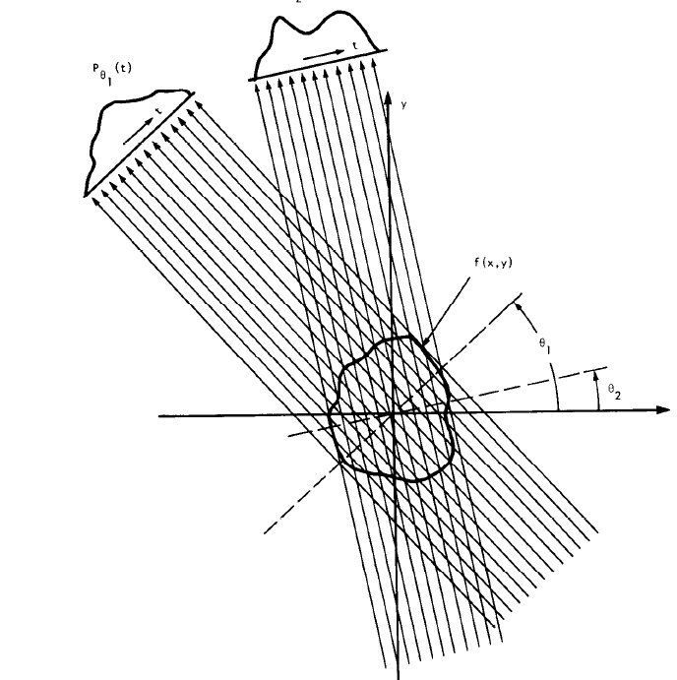
CT Algorithm Geometry
Source: Digital Picture Processing, Rosenfeld and Kak

Slide 62
CT Algorithm Partitions
CT processing has four parts:
Pre-processing
Back projector
Post processing

Slide 63
CT Pre-processing
Performed on each individual set of data collected from all detectors in single angle
Converts from absorption values to real values
Compensates on the variance in the geometry and detectors; Dead detectors are interpolated.
Interpolation using FFT based convolution (x->2x)
Other vector filtering operation (secret sauce)

Slide 64
CT Back Projector
For each pixel, accumulates the contributions of all the lines that passed through the pixel
Involves interpolation between two rays … and adding to a value

Slide 65
Post-processing Image processing
2D filtering on the image:
Scatter (or anti-scatter) filter
Smooth filter (LPF) for a smoother image
Edge detection filter (The opposite) for identifying edges
Setting the range for display (floating point to fixed point conversion)
Other image based operations

Slide 66
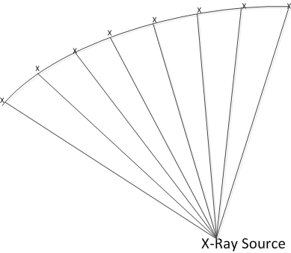
“My System”
800 detectors in a vector
360 vectors per slice
Scan time – 1 second per slice
Image size 512x512 pixels
400 slices per scan

Slide 67
Memory and IO Considerations
Input data per second: 800 * 360 * 2 = 562.5 K Bytes
800 detectors, 2 bytes (16 bit A2D) each detector, 360 measurements in a slice (in a second)
Total input data (562.5K x 400) = ~ 225MB
562.5K each slice, and there are 400 slices

Slide 68
Memory and IO Considerations
Image memory size for a complete scan:
400 slices, 4 bytes (floating point) per pixel, 512x512 pixels
512x512 floating point each
512 x 512 x 4 x 400 = 400MB

Slide 69
Pre-Processing Considerations
Pre-process single vector
Input size (single vector) 800 samples by 2 bytes –less than 2KB
Largest intermediate size (interpolated to 2048, complex floating point) 2048*4*2 = 16KB
Output size (real) 2047 x 4 = 8KB
Filters coefficients, convolution coefficients etc –> 16KB

Slide 70
Image Memory Considerations
Back projector processing
Image size 512x512x4 = 1M
Post processing
400 images, 400M

Slide 71
System Considerations
When scanning starts, images are processed at the rate of one image per second. (360 measurements in a slice)
The operator verifies that all settings and configuration are correct by viewing one image at a time and adjusting the image settings
The operator looks at images slower than one per second and needs flexibility in setting image parameters and configurations.
The operator does not have to look at all the images. The image reconstruction rate is 1 per second. The image display rate is much slower.

Slide 72
ARM - DSP Considerations
The ARM NEON and the FPU are optimized for vector/matrix bytes or half word operations. Linux has many image processing libraries and 3D emulation libraries available.
Intuitively, it looks like the ARM core will do all the image processing.
DSP cores are very good in filtering, FFT, convolution and the like. The back projector algorithm can be easily implemented in DSP code.
Intuitively, it looks like the 8 DSP cores will do the preprocessing and the back projection operation.

Slide 73
“My System” Architecture

Slide 74
Building and Moving the Image
In my system, the DSPs build the images in shared memory
Unless shared by multiple DSPs (details later), L2 is too small for a complete image (1MB), and MSMC memory is large enough (up to 6MB) and closer to the DSP cores (than the DDR)
Moving a complete back-projector image to DDR can be done in multiple ways:
One or more DSP cores
EDMA (in ping-pong buffer setting)
ARM core can read directly from the MSMC memory and write the processed image to DDR (again, in ping-pong setting)
Regardless of the method, communication between DSP and ARM is essential

Slide 75
Partition Considerations: Image Processing
ARM core L2 cache is 4MB
Single image size is 1MB
Image processing can be done in multiple ways:
Each A15 processes an image
Each A15 processes part of an image
Each A15 processes a different algorithm
Following slides will analyze each of the possible way

Slide 76
Image Processing: Each A15 Processes a Different Image
A15 supports write-through for L1 and L2 cache.
If the algorithm can work in-place (or does not need intermediate results), each A15 can process a different image; Each image is 1MB.
Advantage: Same code, simple control
Disadvantage: Longer delay; Inefficient if intermediate results are needed (or for the not-in-place case).

Slide 77
Image Processing: Each A15 Processes a Part of the Image
The cache size supports double buffering and working area.
Intermediate results can be maintained in cache, output written to a non-cacheable area.
Advantage: All data and scratch buffers can fit in the cache; Efficient processing, small delay.
Disadvantage: Need to pay attention to the boundaries between processing zones of each A15.

Slide 78
Image Processing: Each A15 Processes a Part of the Algorithm
Pipeline the processing; Four images in the pipeline: Requires buffers
Advantage: Each A15 has a smaller program, can fit in the L1 P cache
Disadvantage: Complex algorithm, difficult to balance between A15, not efficient if memory does not fit inside the cache.

Slide 79
Conclusion
The second case (each A15 processes quarter of the image) is the preferred model

Slide 80
DSP Cores Partition -preprocessing
There are 360 vectors per slice.
Each vector pre-processing is independent of other vectors
Thus the complete preprocessing of each vector is done by a single DSP core
There is no reason to divide preprocessing of a single vector between multiple DSPs.

Slide 81
Preprocessing and back projector
Partition pre-processing and back projector options:
Some DSPs do pre-processing and some do back projector (Functional Partition)
All DSPs do both preprocessing and back projector (Data Partition)

Slide 82
Functional Partition
N DSPs do preprocessing; 8-N back projector
N is chosen to balance load (as much as possible)
Vectors are moved from the pre-processing DSPs to the back projector DSP using shared memory or Multicore Navigator.

Slide 83
CT Back Projector
How to divide the back projector processing between DSP cores?

Slide 84
Case I -Functional Partition: Complete Image
Each DSP sums a complete image:
Vectors are divided between DSPs.
Because of race conditions, each DSP has a local (private) image. At the end, one DSP (or ARM) combines together all the local images. Private image resides outside of the core.
Does not require broadcasting of vector values

Slide 85
Case II -Functional Partition: Partial Image
Each DSP sums partial image:
Vectors are broadcast to all DSPs
Depends on the number of cores; Partial image can fit inside L2
Merged together into shared memory (DDR) at the end of the partial build

Slide 86
Trade-off
Trade-off between broadcasting all vectors and using private L2 to build the image, or not broadcasting L2 and have the image in MSM memory or DDR
How does broadcasting works?
Using shared memory scheme with semaphore
Other ideas
More discussion later

Slide 87
Data Partition
All DSPs do preprocessing and back projector
Just like the previous case, there are two options, either each DSP builds part of the image or all DSP build partial image and then all partial images are combined into the final image

Slide 88
Input Vector Data Partition: Complete Image
Each DSP sums a complete image:
Raw vectors are divided between DSPs.
Because of race conditions, each DSP has a local (private) image. At the end, one DSP (or ARM) combines together all the local images. Private image resides outside of the core.
Does not require broadcasting of raw vector values.

Slide 89
Input Vector Data Partition: Partial Image
Each DSP sums a partial image:
Raw vectors are broadcast to all DSPs.
Depends on the number of cores; Partial image can fit inside L2 in addition to the filter coefficients.
Merged together into shared memory (DDR) at the end of the partial build.

Slide 90
Conclusion
The optimal solution depends on the exact configuration of the system (number of detectors, number of rays, number of slices) and the algorithms that are used.
Suggest benchmarking all (or subset) of the possibilities and choose the best one for a specific problem.
Any Questions?

